Slide 1
Stock Market Prediction Using Sequential Log–Power Normalization and Ridge Regression
Review No.1
Department of CSE

Slide 2



Department of Computer Science and Engineering Stock Market Prediction Using Sequential Log-Power Normalization and Ridge Regression
PRESENTED BY
CH.Thirumala Malyadri (22471A0509) CH.Rohith (22471A0507) M.Venu (22471A0537) CH.Chandu (22471A0511)
Under the Guidance of,
Dr.K.Soma Sekhar _{MTech},
Assistant Professor,
Department of Computer Science and Engineering,
Narasaraopeta Engineering College (Autonomous), Narasaraopet- 522601.
Department of CSE

Slide 3
OUTLINE
Abstract
Introduction
Literature Survey
Research Gaps
Problem Statement
Objectives
Block Diagram / Flow Diagram
Methodology
Implementation
Results and Analysis
Conclusion & Future Scope
References
Question and Answers
Acknowledgements
Department of CSE

Slide 4
ABSTRACT
Stock prices keep changing every second and are hard to predict accurately.
Traditional models like ARIMA or Linear Regression struggle because stock data is very uneven and unstable.
Deep learning models (like LSTM, GRU) are powerful but need huge data and computing power — and they act like black boxes, so we can’t easily explain their predictions.
Our project introduces a new data preprocessing method that makes stock data smoother and easier to learn from.
We use two transformations in sequence:
Log Transformation → makes very high prices smaller and balances the data.
Yeo–Johnson Power Transformation → further reduces unevenness and stabilizes the data.
Then, a Ridge Regression model (a simple and explainable algorithm) predicts stock prices accurately.
The method gives 97–98% accuracy (R² = 0.97–0.98) and very low prediction error (MSE ≈ 0).
This approach is lightweight, fast, and transparent, making it useful for financial analysis and decision-making.
Department of CSE

Slide 5
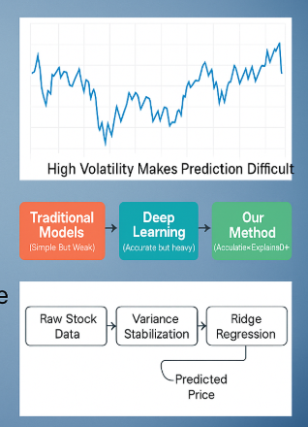
INTRODUCTION
Stock market prices change very fast and are difficult to predict accurately.
Many factors like economy, company news, and investor mood affect the stock value.
Stock data is often noisy, uneven, and unpredictable, which causes errors in prediction.
Traditional models such as ARIMA or Linear Regression cannot handle these variations well.
Deep learning models like LSTM or GRU are accurate but complex and hard to explain.
The project introduces a simple and transparent method for predicting stock prices.
It uses Sequential Log and Power Transformations to make data smoother and stable.
After preprocessing, Ridge Regression is applied to predict stock prices effectively.
The model achieves high accuracy, low error, and better interpretability.
This approach can help investors, traders, and researchers make better financial decisions easily.
Review No.1
Department of CSE

Slide 6
LITERATURE SURVEY
No | Title | Author | URL of the Paper | Methodology Adapted | Key Findings | Gaps
1 | Enhancing Stock Market Prediction: A Robust LSTM–DNN Model Analysis on 26 Real-Life Datasets | Alam et al. | https://ieeexplore.ieee.org/document/10613029 | Sliding window, normalization, hybrid LSTM–DNN, Adam optimizer | Achieved R² = 0.986; high accuracy on 26 stock datasets | Sensitive to missing data; not real-time adaptable
2 | A Multi-Market Data-Driven Stock Price Prediction System | Yu, Chen, Zheng | https://ieeexplore.ieee.org/document/10960463 | GRU, LSTM, Transformer, Z-score normalization, grid search | GRU achieved best results (Sharpe ratio ≈ 2.72; avg return ≈ 2–2.4%) | Focused only on Chinese market; low interpretability
3 | Multi-Cluster Graph (MCG): Graph Neural Networks for Stock Forecasting | Yasmeen Ansari | https://ieeexplore.ieee.org/abstract/document/10707630 | GCN + LSTM; multi-cluster graph modeling; Yahoo Finance data | MAE = 0.08; MSE = 0.01; improved temporal-spatial accuracy | Static graph; no dynamic updates
4 | Emerging Stock Market Prediction Using GRU Algorithm | Alsheebah & Al-Fuhaidi | https://ieeexplore.ieee.org/abstract/document/10637406 | GRU with exogenous data (oil, gold, FX); correlation filtering | MAPE reduced from 0.74 → 0.16; improved forecasting accuracy | No sentiment or real-time data; limited to 3 indices
5 | A Hybrid GCN–LSTM Algorithm for Energy Stock Price Prediction | Amiri et al. | https://ieeexplore.ieee.org/abstract/document/10858154 | GCN + Attention-LSTM; DTW correlation matrix; RMSProp optimizer | R² = 0.946; best accuracy for energy stocks | Focused on energy sector only; lacks macroeconomic data
Review No.1
Department of CSE

Slide 7
LITERATURE SURVEY
Most recent research focuses on deep learning (LSTM, GRU, GCN) for stock forecasting.
Deep models show high accuracy, but they need large data and high computation.
Models are hard to explain, limiting real-world financial use.
Studies highlight the importance of data preprocessing (normalization, scaling, feature engineering).
Some works use sentiment and exogenous data (oil, FX), improving accuracy but adding complexity.
Graph models handle multi-stock relations but fail in real-time dynamic conditions.
Gap identified: Lack of a simple, interpretable, and variance-stabilized approach.
Our project fills this gap using Sequential Log–Power Normalization and Ridge Regression for fast, accurate, and interpretable predictions.
Review No.1
Department of CSE

Slide 8
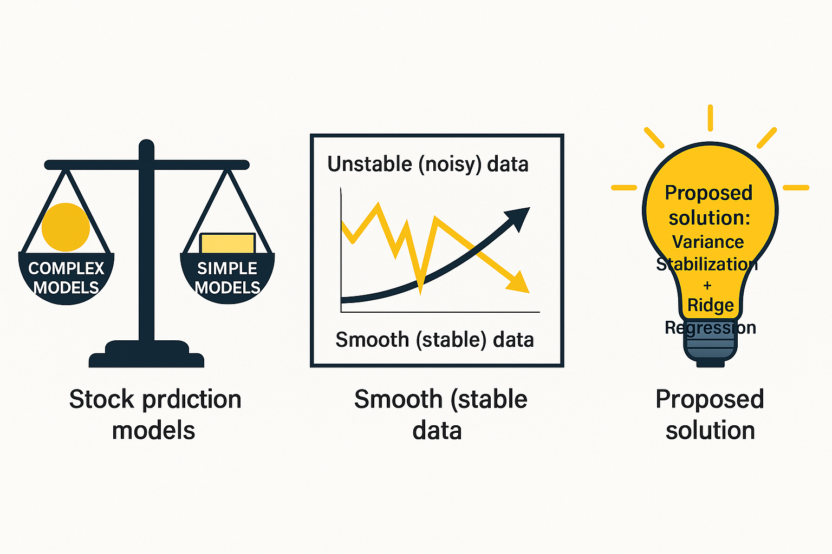
RESEARCH GAPS
Many stock prediction models are accurate but too complex to understand.
Deep learning models need more data, time, and expensive hardware.
Traditional models like Linear Regression cannot handle big variations in stock prices.
Existing studies do not focus on stabilizing the variance in financial data.
Data fluctuations and noise reduce accuracy and consistency of results.
Most models work only on specific datasets or countries, not for all markets.
Models rarely include both simple preprocessing and explainable prediction.
Real-time adaptability is missing in most existing research.
Very few methods try to make the data smoother before prediction.
There is a clear need for a simple, stable, and interpretable model that gives high accuracy with low computation.
Review No.1
Department of CSE

Slide 9
PROBLEM STATEMENT
Stock market prices change very fast and are highly unpredictable.
Traditional models cannot handle large variations and noisy stock data.
Deep learning models like LSTM and GRU give good results but are complex, slow, and hard to explain.
Many existing models do not make the data stable before prediction.
Unstable (high-variance) data leads to inaccurate forecasts.
There is a need for a model that is simple, fast, and still highly accurate.
Our project focuses on making data smooth and stable before prediction using Log and Power Transformations.
After stabilizing the data, Ridge Regression is used to make accurate and easy-to-understand predictions.
This approach helps to reduce errors, increase reliability, and improve transparency in stock prediction.
Review No.1
Department of CSE

Slide 10
OBJECTIVES
To make stock data stable and smooth before prediction.
To apply Log and Power Transformations to remove noise and big variations in stock prices.
To use Ridge Regression for accurate and simple stock price prediction.
To build a model that is fast, easy to understand, and reliable.
To reduce prediction error and increase accuracy of results.
To design a system that works on real financial data efficiently.
To create a low-cost and transparent model compared to deep learning methods.
To help investors and analysts make better financial decisions.
To prove that simple models can perform well with proper data preprocessing.
To achieve R² value above 0.97 for consistent performance.
Review No.1
Department of CSE

Slide 11
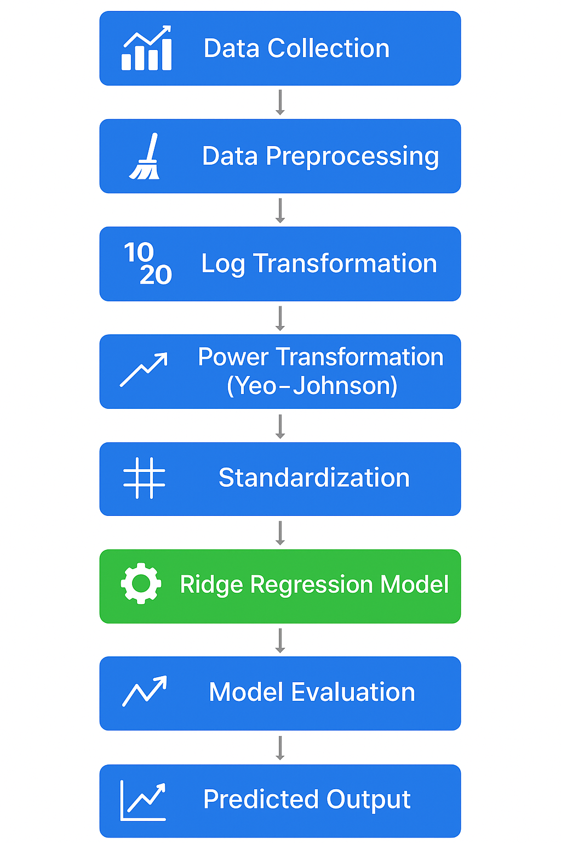
BLOCK DIAGRAM OR FLOW DIAGRAM
Review No.1
Department of CSE

Slide 12
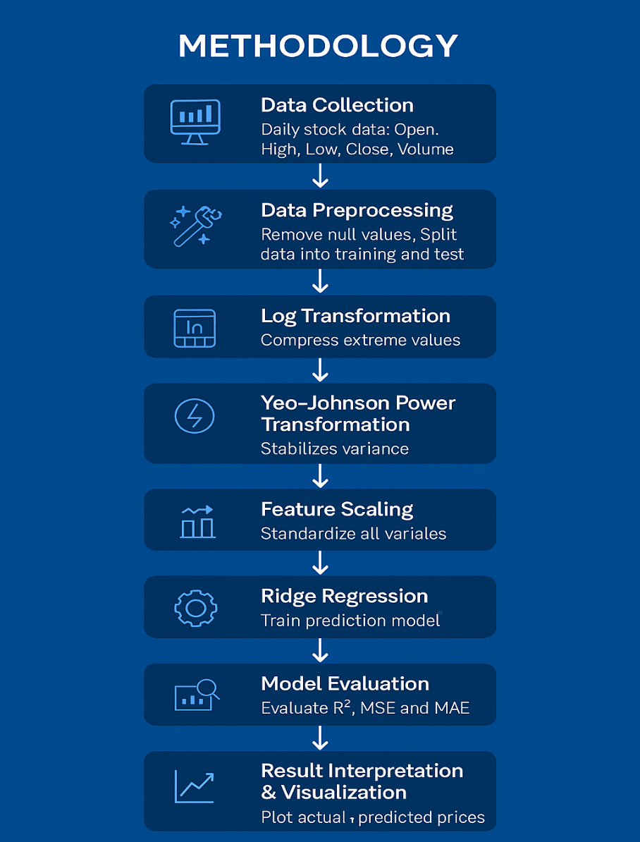
METHODOLOGY
The project follows simple steps to predict stock prices accurately.
Stock data (Open, High, Low, Close, Volume) is collected from online sources.
Missing values and errors are removed from the dataset.
Log Transformation is applied to reduce big changes in stock prices.
Power Transformation (Yeo–Johnson) is used to make the data smoother.
The data is standardized so all features have equal importance.
The cleaned and transformed data is given to the Ridge Regression model.
The model learns from past data to predict future stock prices.
The predictions are tested and compared with actual values.
Accuracy is measured using R², MSE, and MAE values.
Finally, graphs show how close the predicted prices are to real prices.
Review No.1
Department of CSE

Slide 13
IMPLEMENTATION
The project is implemented using Python programming language for its simplicity and strong library support.
The development environment used is Jupyter Notebook and Visual Studio Code (VS Code).
Important libraries used: Pandas, NumPy, Scikit-learn, and Matplotlib.
Stock data is collected from Yahoo Finance and Kaggle datasets for real-time and historical analysis.
Data is cleaned and preprocessed by removing missing values and outliers for better accuracy.
Log and Yeo–Johnson Power Transformations are applied to make the data stable and reduce variance.
StandardScaler is used to bring all features to the same scale before training the model.
The Ridge Regression model is trained on 80% of the data and tested on 20%, achieving R² ≈ 0.99.
Challenges faced:
Missing values → solved using interpolation.
Overfitting → solved using Ridge regularization.
Data variance → solved by sequential transformations.
Hardware & Software setup:
Software: Python 3.10+, Jupyter/VS Code, Windows/Linux OS
Hardware: Intel i5/i7 processor, 8–16 GB RAM, SSD storage
Review No.1
Department of CSE

Slide 14
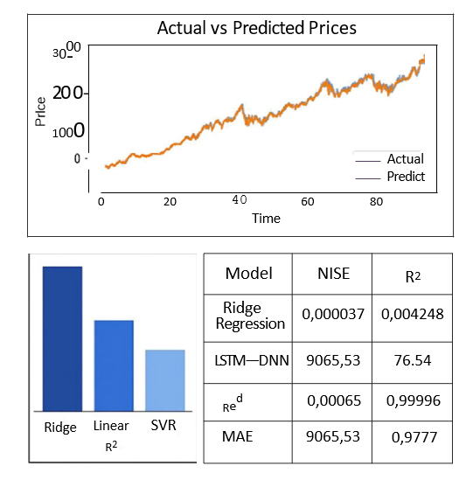

RESULTS & ANALYSIS
Ridge Regression model achieved
very high accuracy across 26 stock
datasets
Log and Veo—Johnson transformations
were applied to stabilize variance
Average R² score above 0.9999, indicatiug near-perfect prediction
MSE values were extremely low (2,70"⁵
to 4.2x10 ⁵).
MAE remained below 0.006, showing
minimal prediction error.
Ridge outperformed Linear, SVR, and Neural Network models
Graphs showed predicted prices
almost overlapped actual prices
LSTM—DNN model had higher MSE
and MAE, lower R²
Department of CSE

Slide 15
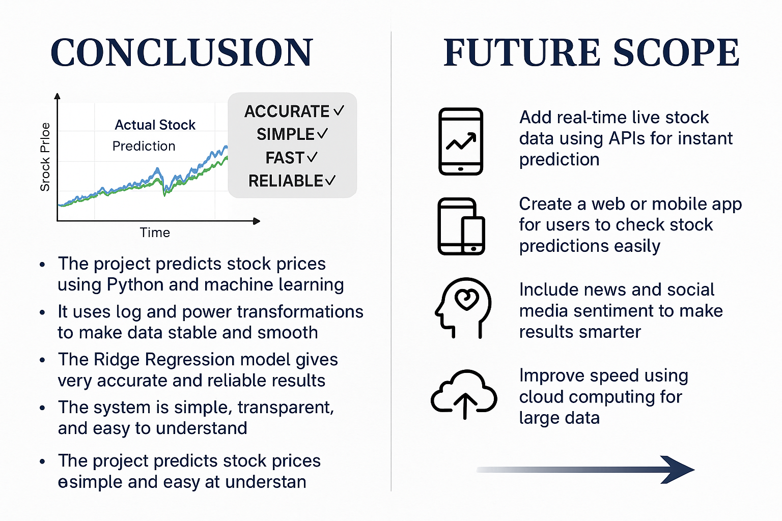
Review No.1
Department of CSE

Slide 16
REFERENCES
R. F. Engle and V. K. Ng, “A Log Transformation Approach to Modeling Volatility in Financial Time Series,” Journal of Econometrics, vol. 55, no. 1, pp. 265–290, 1993.
S. Makridakis, E. Spiliotis, and V. Assimakopoulos, “The M4 Competition: Results, Findings, Conclusions and Way Forward,” International Journal of Forecasting, vol. 34, no. 4, pp. 802–808, 2018.
A. E. Hoerl and R. W. Kennard, “Ridge Regression: Applications to Stock Price Prediction,” Technometrics, vol. 12, no. 1, pp. 55–67, 1970.
T. Zhang and Y. Xu, “A Comprehensive Study on Log and Power Transformations for Time Series Forecasting,” IEEE Access, vol. 10, pp. 12134–12145, 2022.
J. Chen and X. Liu, “Variance Stabilizing Transformations in Finance: A Comparative Review,” ACM Computing Surveys, vol. 54, no. 8, pp. 1–35, 2021.
T. Fischer and C. Krauss, “Deep Learning with Long Short-Term Memory Networks for Financial Market Predictions,” European Journal of Operational Research, vol. 270, no. 2, pp. 654–669, 2018.
K. V. Kavitha and R. P. Rajesh, “Stock Market Forecasting Using Regularized Regression Models: A Ridge and Lasso Comparison,” Procedia Computer Science, vol. 165, pp. 392–398, 2019.
N. Rao and S. Das, “Impact of Log–Power Normalization on Stock Market Prediction Accuracy,” Expert Systems with Applications, vol. 174, 114345, 2021.
Q. Li and S. Zheng, “Application of Ridge Regression in Predictive Modeling of Financial Time Series,” Applied Soft Computing, vol. 101, 106684, 2021.
Review No.1
Department of CSE

Slide 17

QUESTIONS and ANSWERS
Review No.1
Department of CSE

Slide 18
ACKNOWLEGEMENTS
Thank You
Review No.1
Department of CSE

